Slide 1
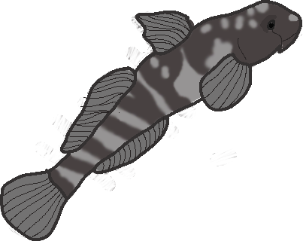
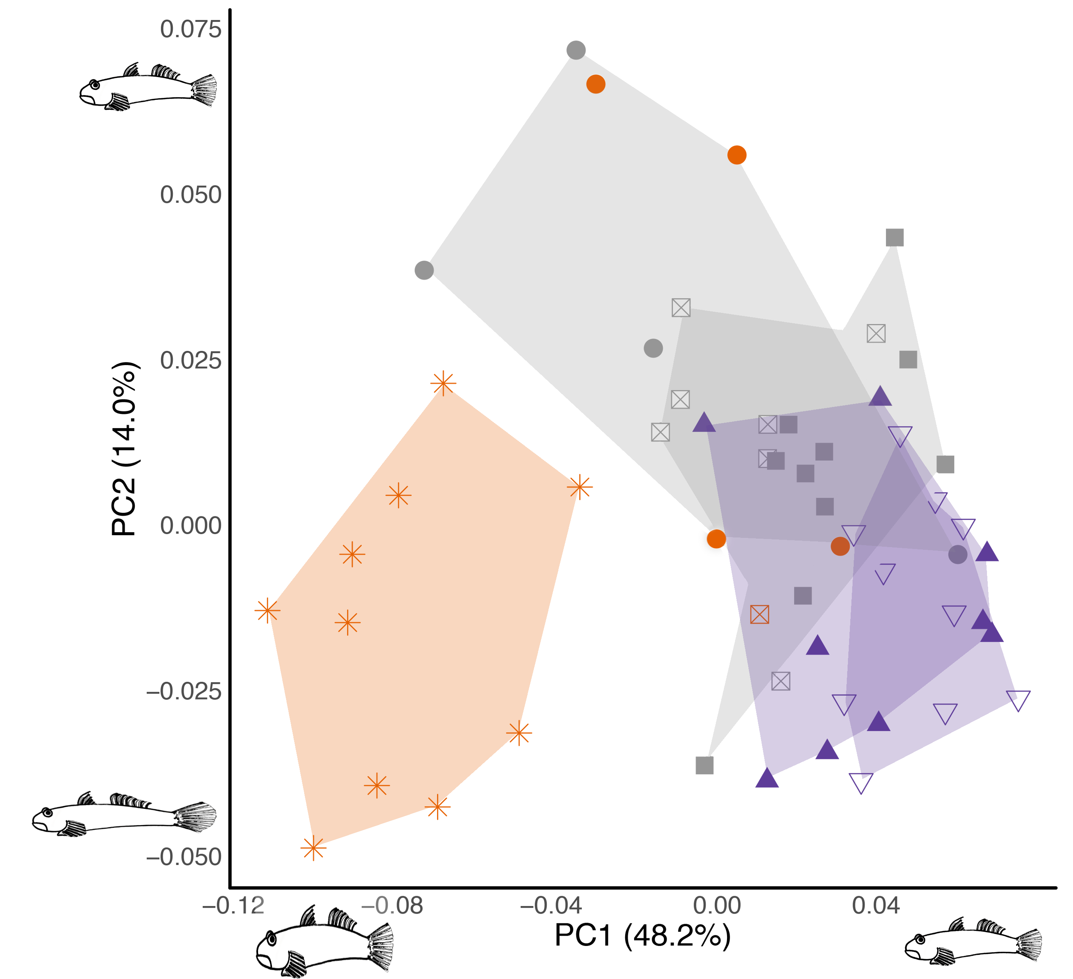
Kelly Diamond Postdoc fellow at Seattle Children’s
General interests: Morphology x performance x behavior in ecological and evolutionary Context
PhD work: Used 2D GMM of body shape to examine morphology x climbing performance x escape behavior/ performance in waterfall-climbing goby fishes

Slide 2
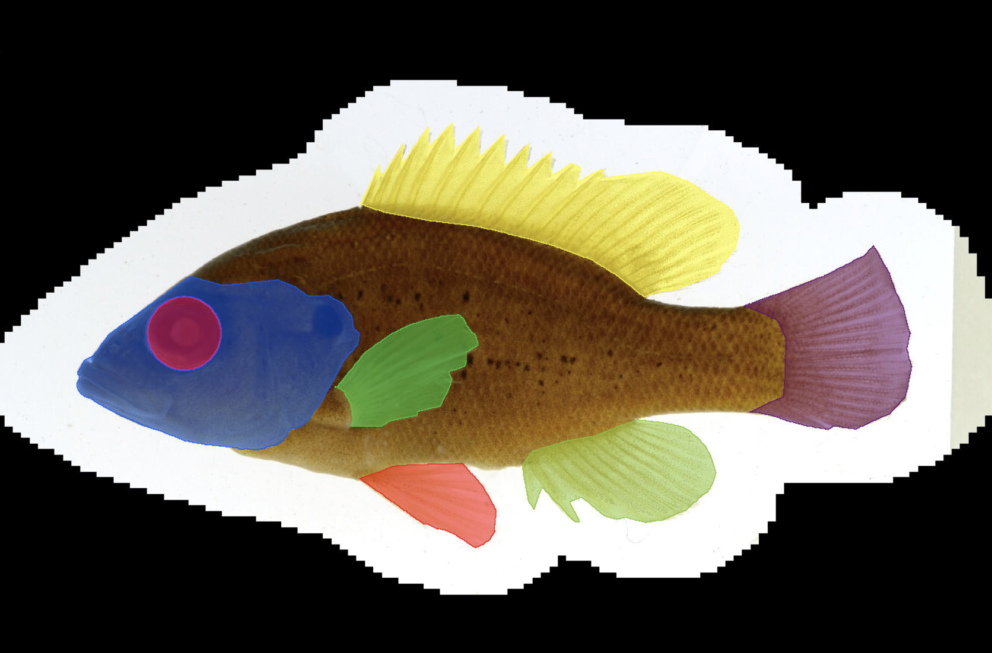
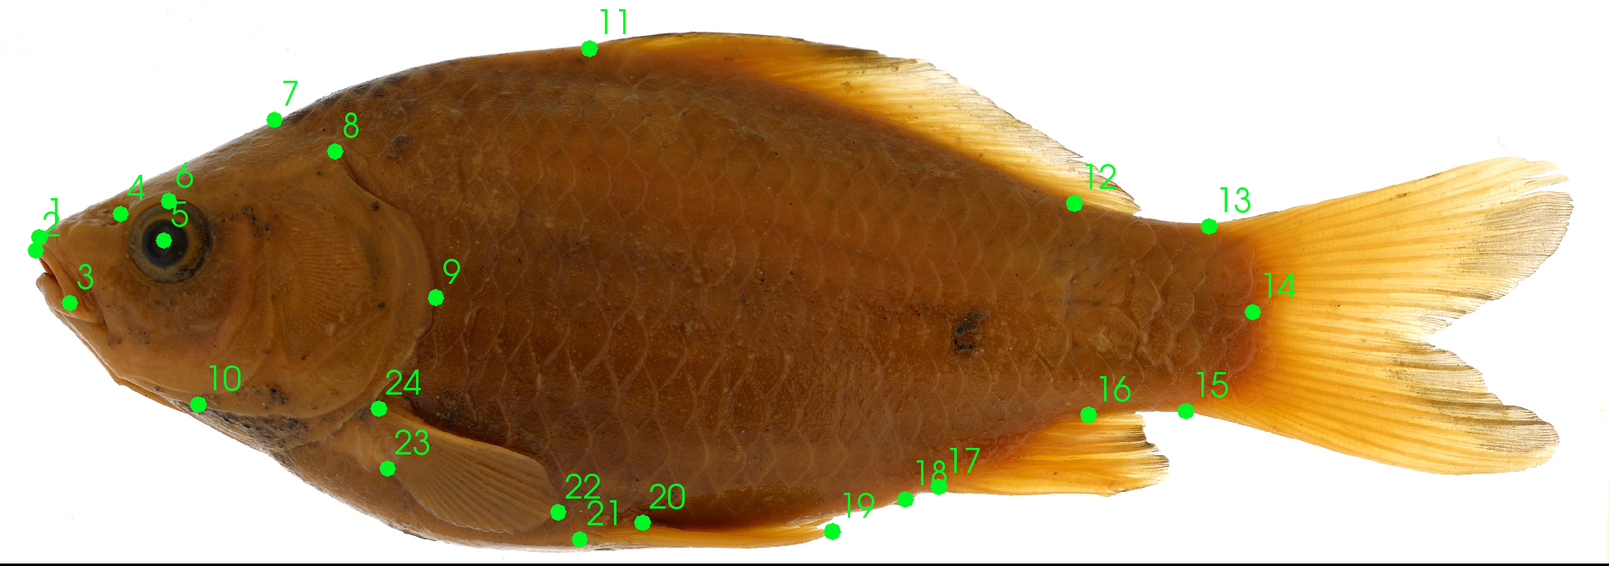
Current project: Using machine learning to segment and identify fish images
Current task: Segment different parts of body that can be used to ‘teach’ computer how to distinguish groups of fishes using images and ontologies
Goal: use ML on 3D GMM datasets
Software: 3D Slicer, R, (learning) python
What I want to learn: Methods/ issues to avoid when processing/ analyzing 3D GMM data

Slide 3

Software: 3D Slicer, R, (learning) python
What I want to learn: Methods/ issues to avoid when processing/ analyzing 3D GMM data
Contact information:
Kelly Diamond
Email: KellyMGDiamond@gmail.com
Website: https://DiamondKMG.github.io/
Twitter & GitHub: @DiamondKMG
Mahalo!

